Slide 1
Vulnerable Road User Initiatives
23 February 2022

Slide 2
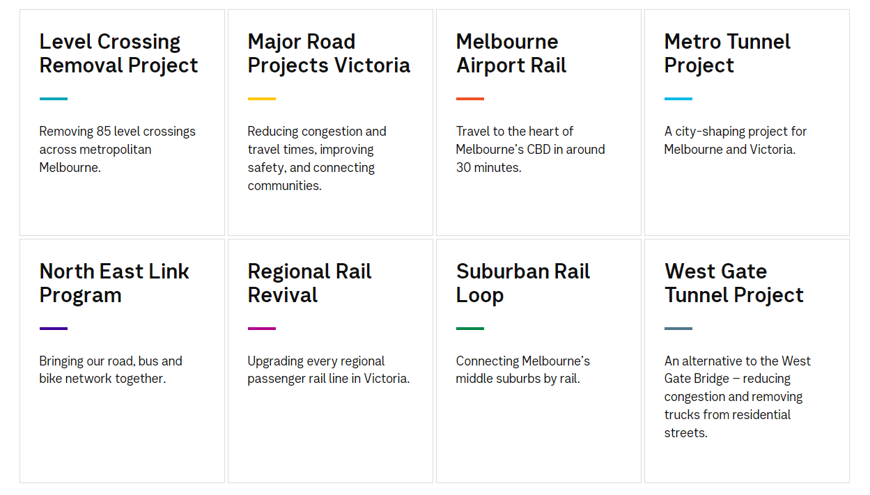
Victoria’s Big Build
Major Transport Infrastructure Authority – MTIA Who We Are
text
Notes:
Victoria’s Big Build is now approaching $100B in total spend
Comprises a series of dedicated Projects Offices / Authorities each delivering specific work streams related to road and rail and often both.

Slide 3
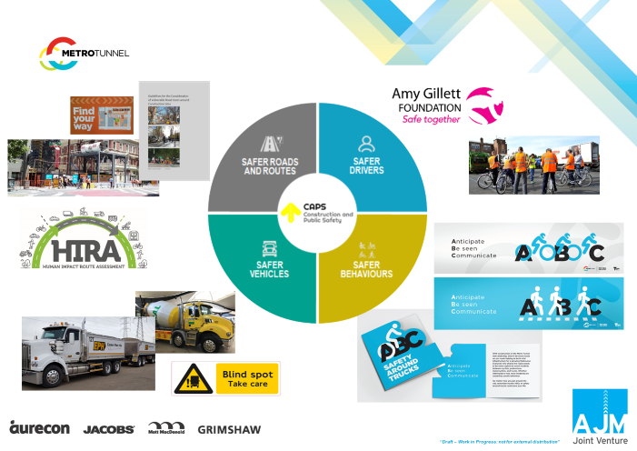
2016 – 2019
Notes:
In late 2016 a workshop was held in Melbourne to bring interested stakeholders together and identify a program of works to enhance protections for vulnerable road users.
Working groups were formed and concentrated on particular activity streams such as truck standards, route selection and management, public engagement and influence, traffic management plans and compliance,
This work enabled the MTIA to consult with industry / stakeholders and ensure that the Vulnerable Road User contract clauses about to be required in major project contracts (e.g. MTP/WGTP) were supported by awareness, understanding of the requirements, guidance, tools, training and checklists during implementation

Slide 4
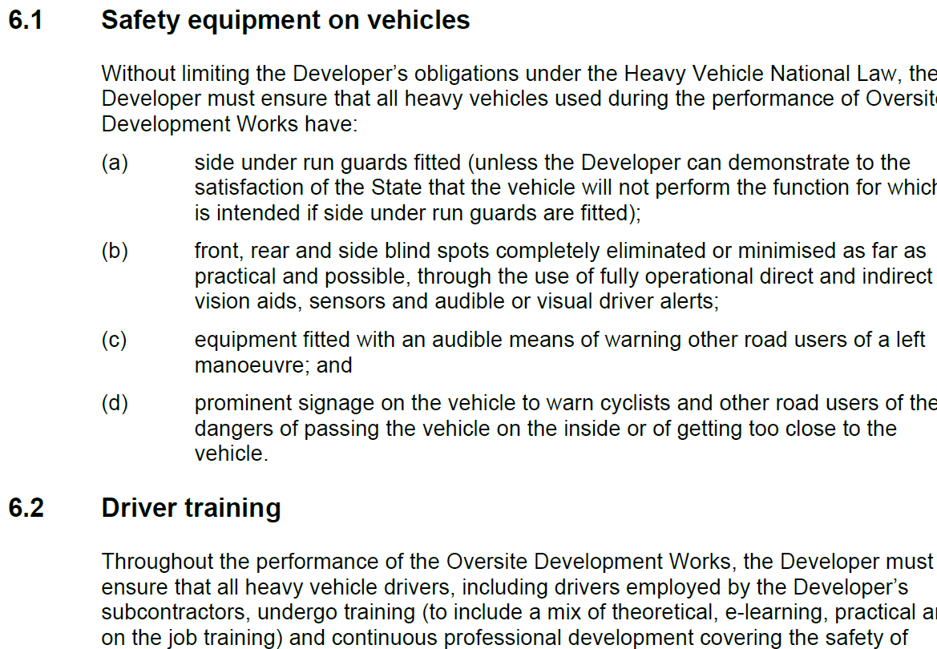
Typical Contract Requirements E.G.
Notes:
These clauses represent the full suite of clauses utilised on Billion dollar plus projects, MTIA presently has almost 50 active infrastructure projects.
MTIA is now commencing VRU rollout on all projects by initially focussing on blind spot elimination, warning signage and driver training.

Slide 5
Implementation Strategy
Major urban projects first (Metro Tunnel, Westgate Tunnel, North East Link all have VRU requirements)
Other projects – progressively requiring blind spot elimination / warning signs / driver training in contracts
Some projects also requiring side underrun / left turn audible alarms dependent on project VRU risk profile.

Slide 6
Challenges
VRU requirements perceived as one way (onus on the industry, not the VRU’s to comply)
The construction industry needed time to understand how to operationalise the requirements – we asked for too much too quickly – needed to stage the implementation.
Major contracts now require a VRU coordinator
A joint working group developed a heavy vehicle specification to translate contractual requirements to operational requirements
Truck fleet age is an issue for retrofitting of equipment such as side underrun where engineering certification was required

Slide 7
Challenges
Left Turn audible alarm technology was not readily available in Australia initially (there are now suppliers / installers)
Not all aspects of the driver training program are accepted by industry (e.g. on bike)
Managing / coordinating interfaces between:
  site access points and complex VRU movement zones
  Placement / management of queuing trucks
  adjoining project activities using heavy vehicles (not MTIA related) but presence of these trucks causes confusion and saturates local areas creating VRU hazards
Pedestrian / Cyclist behaviour in urban environments (walking / riding into vehicles)

Slide 8
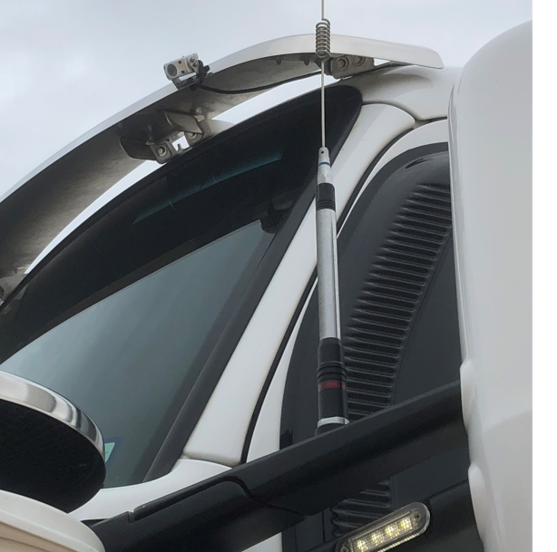
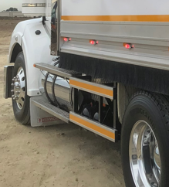
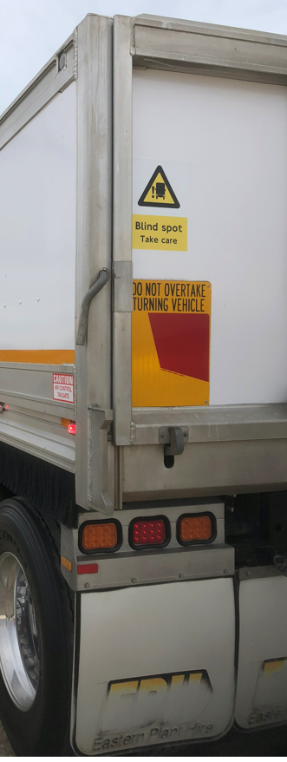
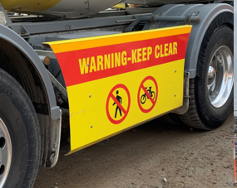
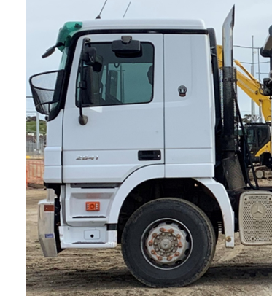
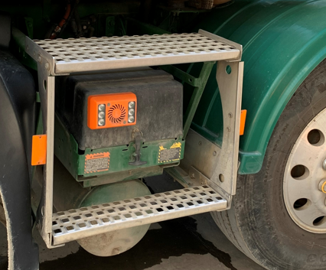
VRU fitted Trucks –reference photos

Slide 9
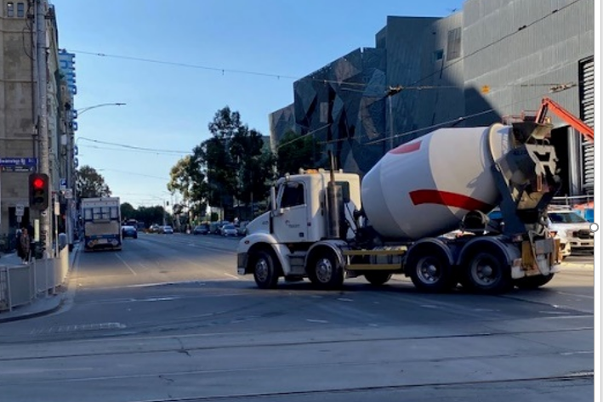
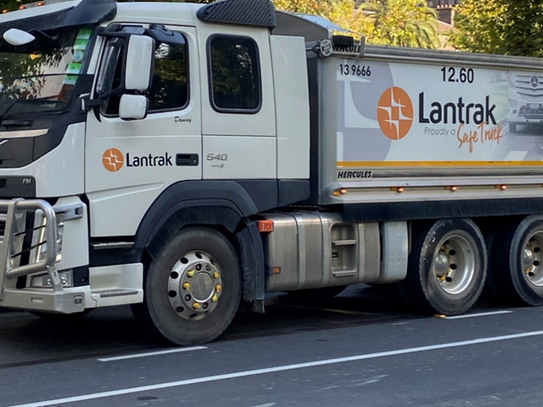
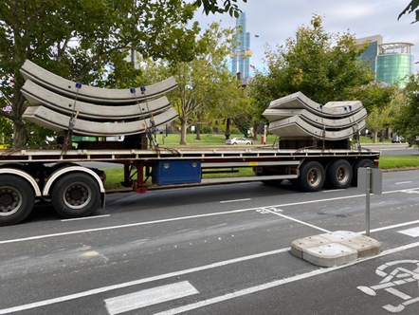
VRU - Site Photos

Slide 10
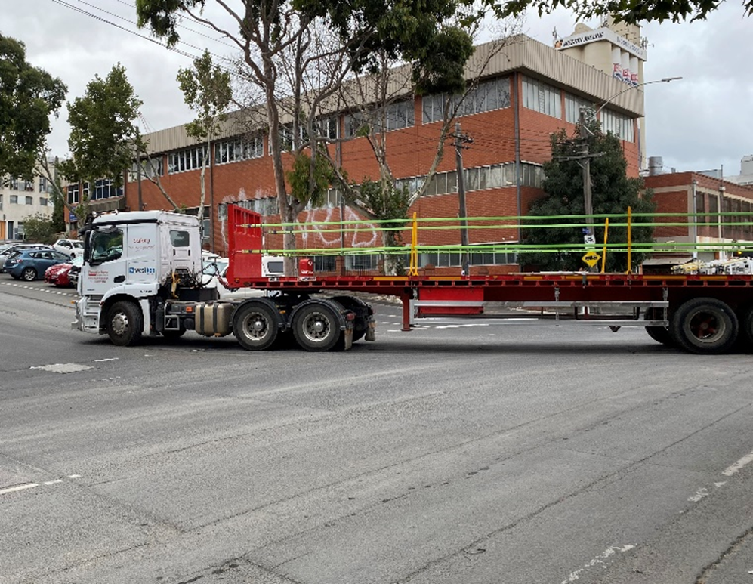
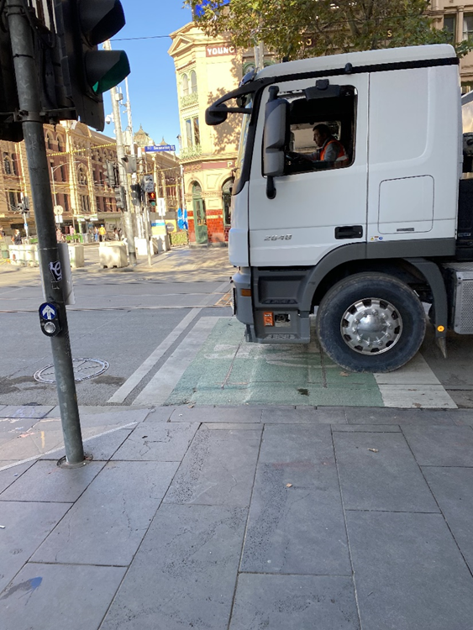
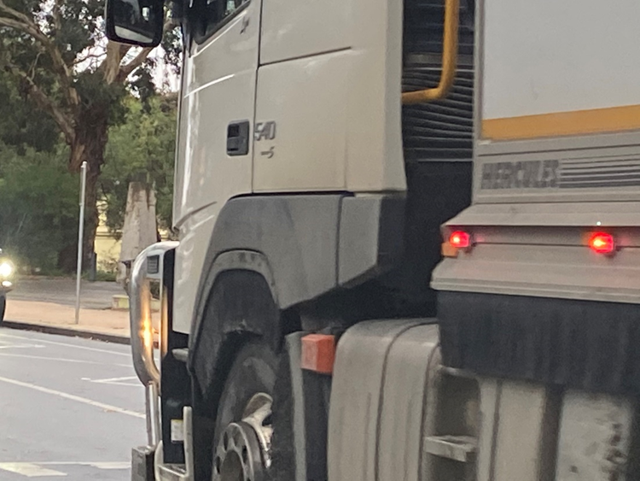
VRU Site Photos

Slide 11
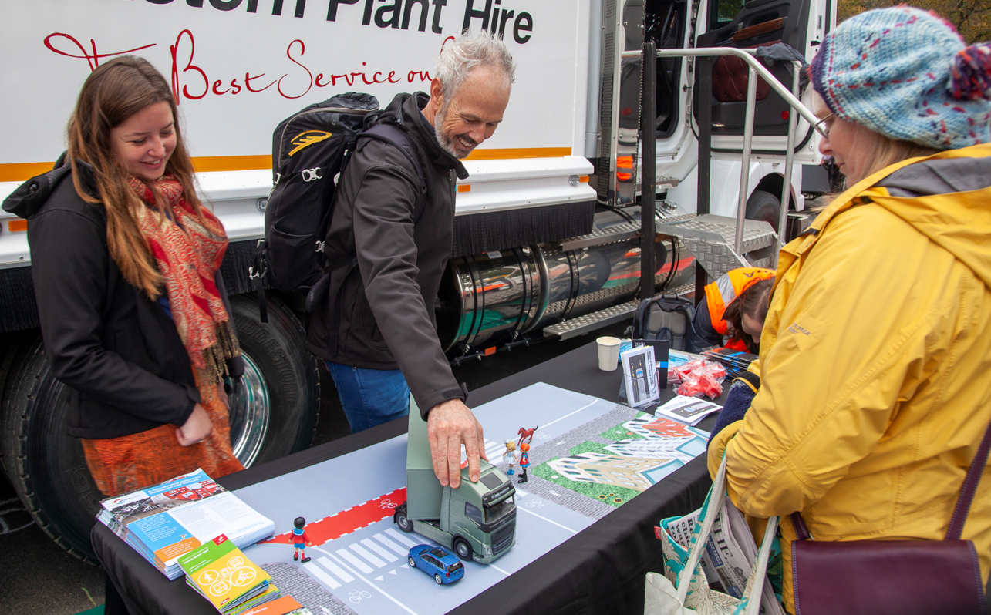
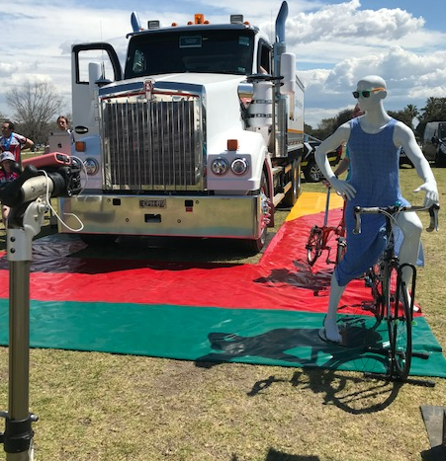
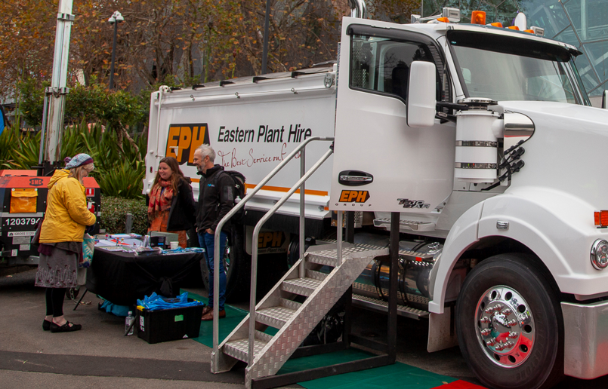
VRU Education is Critical (swapping seats)

Slide 12
VRU Education is Critical (swapping seats)
Truck drivers have no visibility of you when you’re in front of the truck
Visibility is so minimal
I would have thought you could see a lot more from the truck than you can actually see by sitting up here
Oh my god, just keep clear of trucks
It helps people understand how trucks need to manoeuvre around tight corners in the city
It only really comes to life when your really sitting up in the truck
In a nutshell, they (drivers) just can’t see you, that’s confronting
From today, I think I will stop in different places around trucks
That will be a bit of a tweak on my behaviour

Slide 13
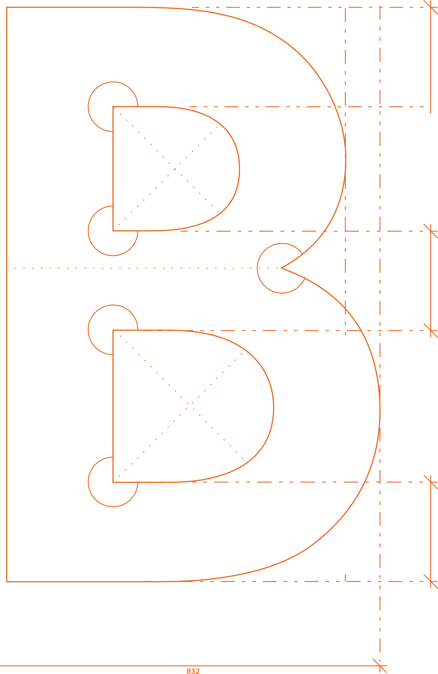
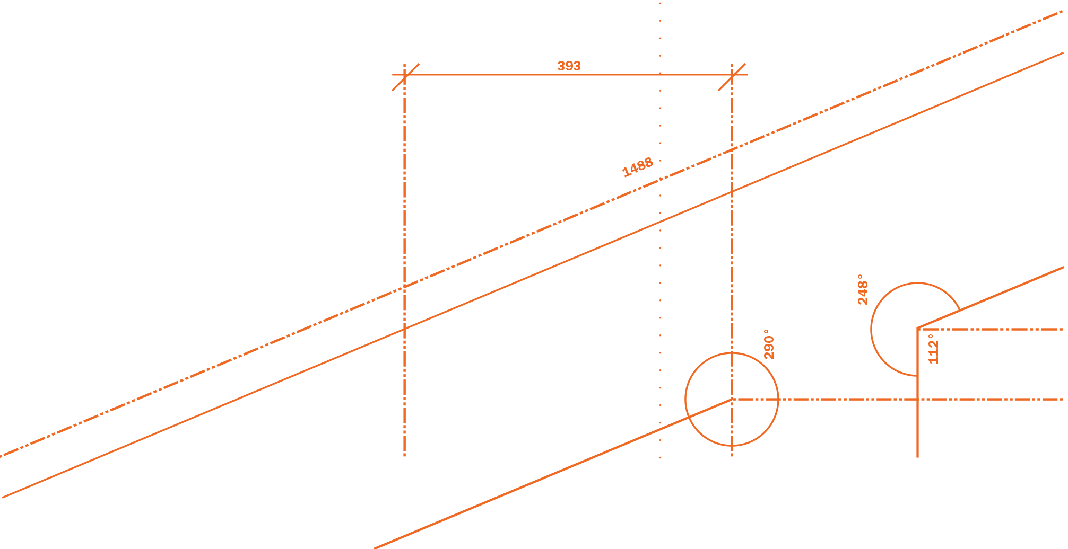
Thank you

